Slide 1



SQL Data Types
Jean-Pierre(JP) Voogt
@JPVoogt
jvoogt1@gmail.com

Slide 2
Data Types
In SQL Server, each column, local variable, expression, and parameter has a related data type.
A data type is an attribute that specifies the type of data that the object can hold: integer data, character data, monetary data, date and time data, binary strings, and so on.
varchar
float
image
int
https://docs.microsoft.com/en-us/sql/t-sql/data-types/data-types-transact-sql?view=sql-server-2017

Slide 3
Data Type Categories
Exact Numerics
bigint
Approximare Numerics
float
Date and Time
Character String
Unicode Character String
Binary String
Other Data Type
bit
decimal
int
numeric
smallint
smallmoney
tinyint
money
real
date
datetime2
datetime
datetimeoffset
smalldate
time
char
text
varchar
nchar
ntext
nvarchar
binary
image
varbinary
cursor
hierarchyid
sql_variant
spatial Geometry Types
table
rowversion
uniqueidentifier
xml
spatial geography types
https://docs.microsoft.com/en-us/sql/t-sql/data-types/data-types-transact-sql?view=sql-server-2017

Slide 4
Large Data Types
Based on their storage characteristics, some data types are designated as belonging to the following groups
Large Value Data Types
varchar(max)
nvarchar(max)
Large Object Data Types
text
ntext
image
varbinary
https://docs.microsoft.com/en-us/sql/t-sql/data-types/data-types-transact-sql?view=sql-server-2017

Slide 5
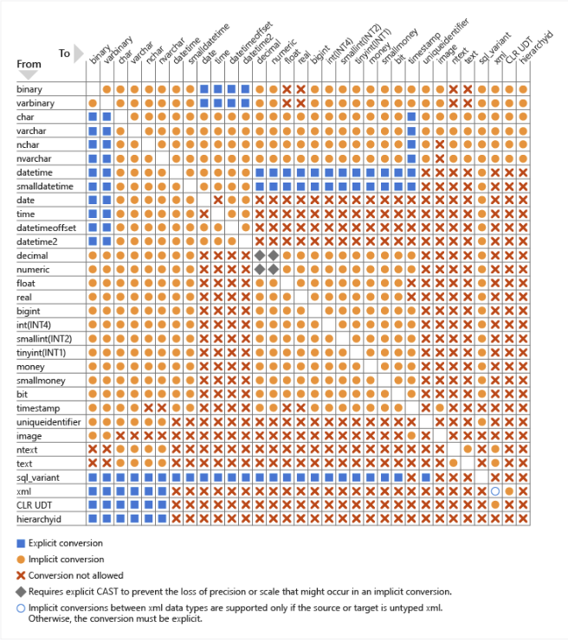
Data Conversion
Implicit
SQL Server Automatically converts the data from one data type to another.
Explicit
Use the cast or convert functions to convert the data from one type to another.
Use CAST instead of CONVERT if you want Transact-SQL program code to comply with ISO.
https://docs.microsoft.com/en-us/sql/t-sql/data-types/data-type-conversion-database-engine?view=sql-server-2017

Slide 6

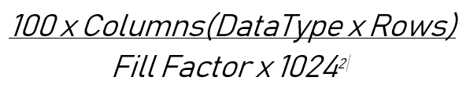
Data Type Size
Using the correct Data Types can help with managing you database size, Below I have created a dummy table with 26 columns with either smallint,int or bigint data types.
bigint use about double the amount of space than an int.
https://docs.microsoft.com/en-us/sql/t-sql/data-types/data-types-transact-sql?view=sql-server-2017

Slide 7
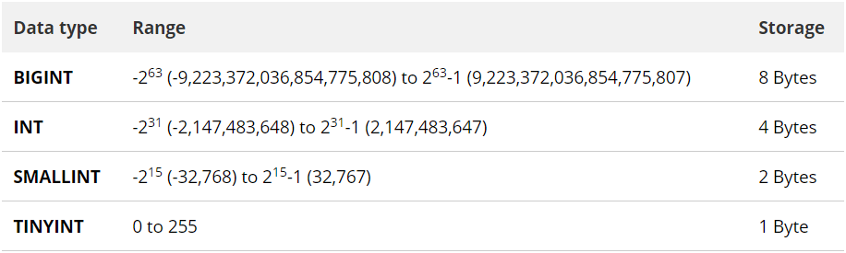
Data Type Restrictions
Data Type | Range | Storage
varchar [(n|max)] | 1 - 8000 | max | 2^31-1 bytes (2 GB)
nvarchar [(n|max)] | 1 – 4000 | max | 2^31-1 bytes (2 GB)
https://docs.microsoft.com/en-us/sql/t-sql/data-types/data-types-transact-sql?view=sql-server-2017

Slide 8
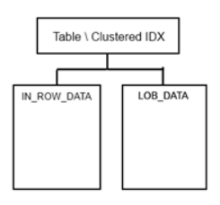
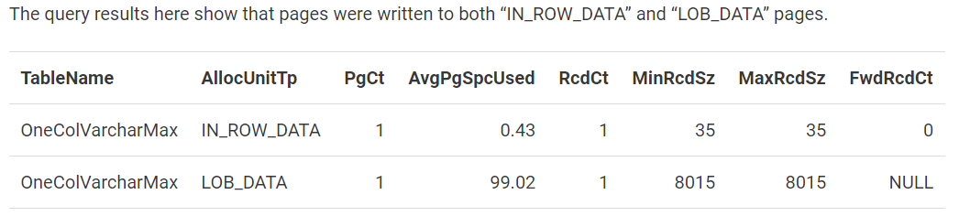
Data Type n|varchar(max)
Data that cannot fit on a traditional 8K byte IN_ROW_DATA page, SQL Server creates a pointer in the data page and move the object to a LOB_DATA page. This behaviour is normally force by using (max) data types.
https://www.red-gate.com/simple-talk/sql/database-administration/whats-the-point-of-using-varcharn-anymore/

Slide 9
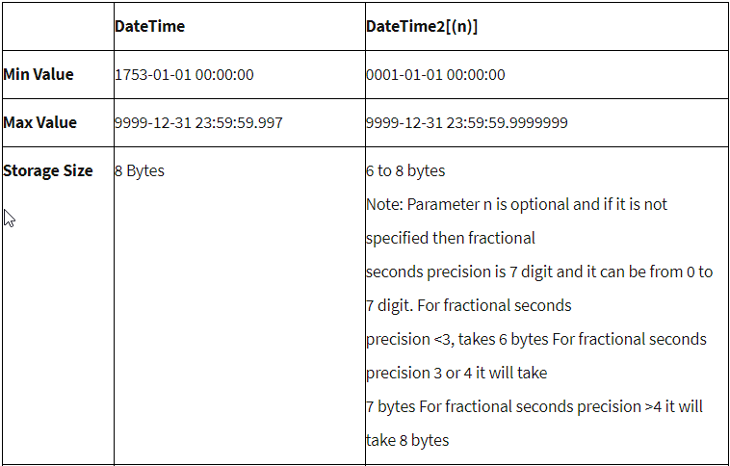
Data Type datetime vs datetime2
DateTime2 is ANSI/ISO compliant where DateTime is not
DateTime2 does not support +(days) notation, you will have to use the datadd function
https://docs.microsoft.com/en-us/sql/t-sql/data-types/data-types-transact-sql?view=sql-server-2017

Slide 10
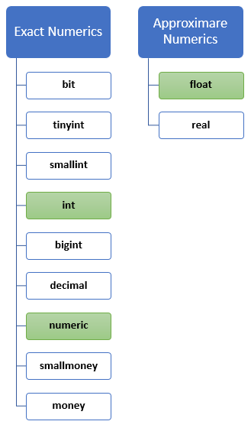
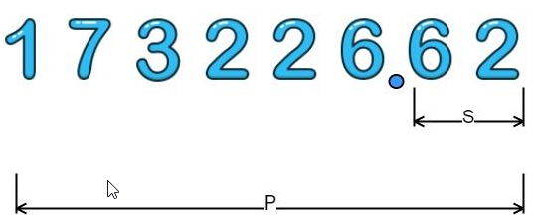
Data Type Approximate vs Exact
What is the difference between an Exact numeric data type and a approximate?
SQL {Most programming language} will store a floating point data type with a base of 10, where an exact gets store exactly how it was captured.
Float is stored as 64bits
Numeric(p[,s])
Precision | Storage bytes
1 - 9 | 5
10 - 19 | 9
20 - 28 | 13
29 - 38 | 17
https://academy.vertabelo.com/blog/understanding-numerical-data-types-sql/

Slide 11
The End

